Slide 1

Descriptive
Pre-Writing
How Detail Enhances Your Writing Voice
Notes:
NOTE: Want a different image on this slide? Select the picture and delete it. Now click the Pictures icon in the placeholder to insert your own image.

Slide 2
Portraying People, Places, and Things
Description presents information in a way that appeals to one or more of the five senses (sight, sound, smell, taste, and touch) by creating an overall (dominant) impression or feeling. This writing is adjective intense!
You use description everyday—to describe new clothes you recently bought, a flavor of gum your tried, or how you defeated Ninja in the video game Fortnite. As mentioned before, another more real situation could be if you were a witness to a car accident; a police officer may question you on giving specific details or descriptors about the wreck. The descriptive account you write for the police could determine who is at fault and who's insurance could pay for damages.
Descriptive writing is used when you want to emphasize the sensory aspects of an object or experience. Some examples can include describing detail in a winter landscape (the way it looks, smells, or feels), writing a detailed review about a restaurant's menu, or describing a professional sports game you went to this past season.
Writers rely heavily on description to present detailed information about people, places, and things to grab their readers' interest.

Slide 3
Characteristics of Description
1.) Description Uses Sensory Details
  Sensory details appeal to one or more of the five senses—sight, sound, smell, taste, and touch—and help your readers experience the object, sensation, event, or person you are describing.
  Sight helps the reader create a mental picture of what you are trying to evoke in your writing.
  Sound can be a powerful descriptive tool. For instance, when describing the motor of an engine, you could use adjectives like "six-cylinder," "make-and-break," "jump-spark," "throbbed," "fluttered," "whined," "purred," etc.
  Smell, though difficult at times to describe, is a very effective descriptive device.
    Example: Driving through farm country can provide sensory details to smell: manure, cut grass, honeysuckle, wheat, scallions, tar, ect.
    Example: Going to the beach can evoke sharp smells also: salt, wet sand, tall grass, heated concrete/roads, sun tan lotion, etc.

Slide 4
Characteristics of Description (Continued)
Taste descriptors make things lively. You could use the adjectives such as "sweet," "bitter," "salty," "tangy," "spicy," etc.
Touch descriptors include that which describe texture, temperature, and weight. This helps the reader personally experience what the narrator is feeling. You could use words like "warmed," "squirmed," "knocks," "heavy," "curvy," "thrashed violently," etc.
2.) Description Uses Active Verbs and Varied Sentences
  Sensory details are often best presented through active, vivid verbs. In fact, active verbs are often more effective than adverbs in creating lasting and striking impressions. For example:
    Original sentence: The team captain proudly accepted the award.
    Revised sentence: The team captain marched to the podium, grasped the trophy, and saluted to his teammates.
  Using varied sentences also contributes to the effective expression of sensory details. Be sure to use different types and patterns of sentences and to vary their lengths.

Slide 5
Characteristics of Description (Continued)
3.) Description Creates a Dominant Impression
  An effective description leaves the reader with a dominant impression—an overall attitude, mood, or feeling about the subject. The impression may be awe, inspiration, anger, or even distaste.
4.) Description Uses Connotative Language Effectively
  Most words have two levels of meaning: denotive and connotative. The denotation of a word is its precise dictionary meaning. Often, however, feelings and attitudes—emotional colorings or shades of meaning—are also associated with a word. These are a word's connotations.
    An example follows:
    Word: Flag
    Denotation: A piece of cloth used as a national emblem.
    Connotations: Patriotism, love, and respect for one's country.
  As you write, be careful to select words with connotations that strengthen the dominant impression you are creating.

Slide 6
Characteristics of Description (Continued)
5.) Description Uses Comparisons
  Comparing the person or object you are describing to something your readers are familiar with can help them visualize your subject. Several types of comparisons are used in descriptive writing: similes, metaphors, personification, and analogies.
    Figure of Speech
    Simile: a direct comparison introduced by words such as like or as
      Example: Her lips were as soft as a feather pillow.
    Metaphor: an indirect comparison describing one thing as if it were another.
      Example: . . .her pillowed lips. . .
    Personification: a comparison that gives human qualities or characteristics to an inanimate object.
      Example: The television screen stared back at him.
6.) Description Follows a Method of Organization
  Effective descriptions must allow for a clear method of organization. Three common methods are spatial order, chronological order, and most-to-least or least-to-most order.
    Spatial order described things from top to bottom, left to right, near to far, etc.
    Chronological order works well when you need to describe events or changes over a period of time.
    You could use most-to-least or least-to-most order to describe the smells in a flower garden or the sounds of an orchestra tuning up for a concert.

Slide 7
Now Let's Practice!
Look at the pictures in the following slides.
In a word document, first name each picture. Then practice descriptive writing by jotting down the things you might hear, smell, taste, see, or feel/touch if you were "in" these pictures.
After you have compiled a brief list of sensory details, write a few descriptive sentences about each picture. This is a practice exercise that should help get your mind thinking about descriptive writing.

Slide 8


Slide 9


Slide 10
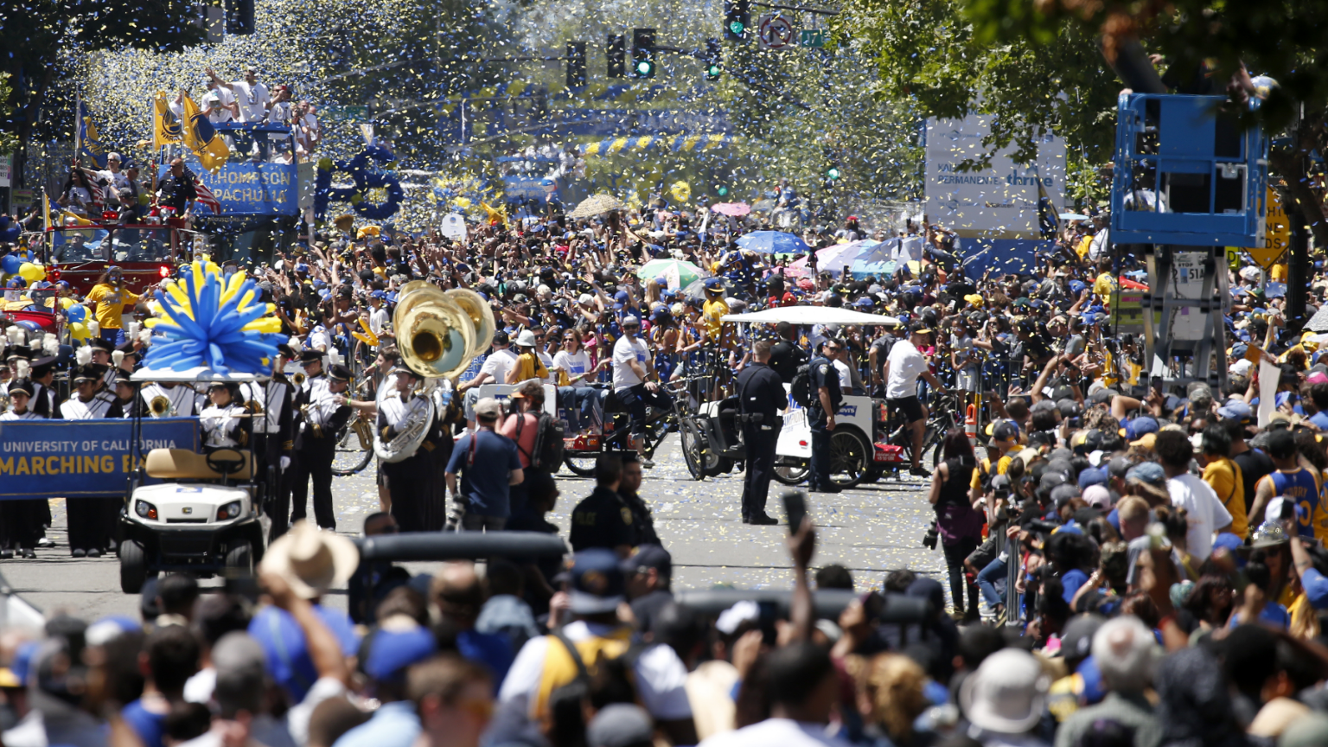

Slide 11


Slide 12
USING descriptors effectively
How Detail Enhances Your Writing to Produce Mental Images
Notes:
NOTE: Want a different image on this slide? Select the picture and delete it. Now click the Pictures icon in the placeholder to insert your own image.

Slide 13
Denotation vs. Connotation
Everyone knows the saying that "A picture is worth a thousand words." The opposite is true, also: “One word is worth a thousand pictures.” Most words have a dictionary definition that specifies what the meaning of that word is. For example, a “church” is a building in which people worship. That is its denotation.
Some people, though, may have an idea in their mind that a “church” is a place to receive comfort, or a building in which marriages are performed, or a place they were forced to go every Sunday as children. Those are the word’s connotations—meanings that are inferred by the person understanding the word “church” through different contexts. A connotation is what is implied by the word. People understand the connotations of words and sentences through their experiences with a specific word and how it has been used.

Slide 14
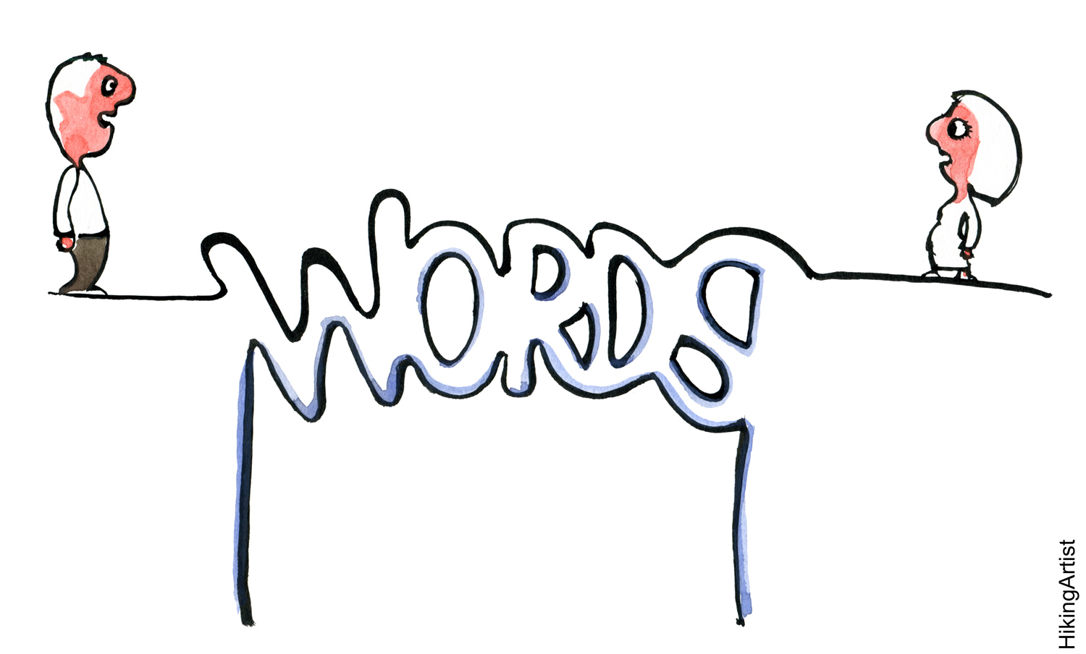
Denotation vs. Connotation (Continued)
While the denotation of something does not change—the sky is the sky, regardless of the weather, the time, or the season—the connotation will change: The sky might be threatening if UFO’s are suddenly seen in it, or if there is a tornado approaching. It is vital to know both when you are reading and writing.
That’s why the English language has so many different words for the same thing. By developing a powerful vocabulary, you can add richness and depth to your ability to communicate.
•

Slide 15

The Three Elements of "Connotative" Meaning
1. Shades of meaning—There are many connotations that depend on shades of meaning of a word. As an example: If you want to say that the weather outside is hot, but you don’t want to give the temperature an actual number, you might say that the air is baking, stifling, sweltering, equatorial, scorching, sizzling, boiling, or burning. Notice how the terms move from a mild form of hot to something that is positively dangerous.

Slide 16

The Three Elements of "Connotative" Meaning (Continued)
2. Positive of negative associations – The second element of a word’s connotation is its positive of negative character. Many words have the exact same denotative meaning but have very different connotative uses. The word “passionate” has the same denotative meaning as “zealous”—having or showing strong and earnest feelings on a topic—but the words have opposite connotative meanings. “Passionate” is generally used when describing something positively—eg., He loved his dog passionately— and “zealous” is used when describing something negatively—e.g., He guarded his money zealously. Note that neither adverb would work if it were substituted for the other, simply because of their connotations.

Slide 17

The Three Elements of "Connotative" Meaning (Continued)
3. Personal Interpretation—A third aspect of connotative meaning is interpretation. People understand what a word means because of their background and their previous experience with the word. This allows each person to interpret words differently from the way other people do. “Strong” may bring about thoughts of a wrestler, or a storm, or even a smell or taste. “Dark” simply means the absence of light, which is its denotation, but “dark” has the connotation of fear, mystery, suspense, confusion, nighttime, gloom, shadows, and more. It all depends on the associations people have had with the word.

Slide 18
Example Through Activities
Activity 1: In your Word document, label Activity 1 and then rank the following six adjectives in order of level of severity from weakest to strongest:
Awful, Terrible, Bad, Abysmal, Poor, Shoddy
All of these words have the same basic meaning, "of poor quality." Yet each of them has a different connotative meaning. People will invariably order the words differently.
Let's try one more time:
Interesting, Absorbing, Fascinating, Enthralling, Intriguing, Captivating
What are some other adjectives that can be sorted in descending or ascending level of intensity?

Slide 19
Examples Through Activities
Activity 2: Look at the following four sets of words. For each set, write down which word has a positive connotation, and which one has a negative connotation.
Youthful/Childish, Skinny/Slim, Cocky/Confident, Boisterous/Noisy
As you can see, each pair of words has a similar meaning. Yet each has a different positive or negative connotation.
What are some other pairs of words that are near synonyms but have both a negative and positive connotation? Here are some more examples:
Unclean/Dirty, Old/Ancient, Interrupt/Disturb

Slide 20

Personal Interpretation Example
When we talk about something as multi-faceted as the ocean, there are many images and personal connections that determine the word’s connotations. Some express all three elements that have been covered and which may or may not be related to each other in terms of interpretation.
Activity 3: Write ten words that relate to the word "ocean."
Some of your descriptors may be "peaceful" while others may not. Because of each person's personal experience with the "ocean," each person may have different words associated to it. Some may be negative, some may be positive.
As you make your list of words, notice how each word creates a mental picture in your mind. Some can be associated with the five senses: sight, smell, touch, taste, and hearing.
•

Slide 21

Activity 4:
The Power of Connotation
-The following two paragraphs tell the same story. However, word choice makes them entirely different. This is done through the successful use of connotations and effective descriptors. What are your impressions of each?

Slide 22
The Power of Connotation
When the young marshal strolled onto the filthy main street of 1885 Tombstone, Arizona, he worried that a hidden killer might be lurking behind the pile of broken wagon parts on the left, so he walked slowly and carefully. He looked cautiously, staring, squinting through the noonday sun’s glare. Nothing! A light film of summer dust clung to his leather boots; the ever-present particles in the air made him cough quietly. A sudden movement to his right startled him, and his gun left his holster quickly, but he saw only a scrawny mutt digging in the dust for a previously chewed bone. He grimaced and hesitantly put the revolver back.
The experienced lawman sauntered through the muddy main street of 1885 Tombstone, Arizona. He knew that a killer might be waiting around the next corner, so he took his time. He glanced warily, keeping his eyes half-shut in the noon day sun. Nothing bothered him, not even the constant dirt that covered his worn leather boots. He coughed from the dust in the air. A quick movement to his right caught his eye and made him turn quickly. The gun flew out of his holster in an instant. A thin dog was scrounging through the dirt trying to locate its old worn-out bone. He smiled and confidently put the six-shooter back.

Slide 23
Write Your Own Paragraph - People
Let's take this a step further. Activity 5: In the same document, write a storied paragraph using the sentence below for plot. Use connotation and descriptors to tell your story effectively. Use complete sentencing and diction.
"The woman at the diner."
Who is she?
What is she doing at a diner?
Is she happy, sad, sleepy, etc?
How is she dressed?
Does she have someone with her?
What kind of diner is she at?
Details. Details. Details!

Slide 24
On to Places - Setting
As you can see, when you include explicit details, descriptors, connotative language, and figurative language, you writing is given a sense of "depth." It allows the reader to not only form mental images inside their head, but to "feel" what the narrator is writing about. Let's take it to the next step, which is describing "places."
"Places" or "settings" are very significant in evoking a certain atmosphere within a written text. These places or settings of "atmosphere" can sometimes range from being calm or passive to threatening or dangerous. The "place"/"setting" is what surrounds the writing giving it an even more alluring affect.
Think of Harry Potter's "place" or "setting." Without Hogwarts, the books would be missing something vital to the storyline. Also, think of any other book or movie. Without a "place" or "setting," they would actually have no appeal at all.

Slide 25

On to Places - Setting
For Activity 6, write a paragraph describing a city. Describe this "place" with descriptors and heavy details. Place yourself within the city and use your five senses to extract its "atmosphere."

Slide 26

On to "Things"
When describing "things" in writing, try to use your five senses to the max. The best two senses to use are sight and touch (texture). Yet you could also describe how something smells or sounds when used a specific way. At times when describing "things" we get too complex or over detailed.
For instance, have you ever been given directions to something or somewhere that were too detailed, and you get lost? This can happen in writing if you are not careful. You want to use descriptors and details to your advantage in writing but remember to not get too complicated. This causes the reader to get "lost" and lose interest.
For Activity 7, write a paragraph about an abandoned car on the side of the road. Use those five senses!

Slide 27

Combine All Three!
Now, combine all three: a person, place, and thing. Activity 8: Write a paragraph about the following:
Holding a gun in the dark room, the man muttered under his breath, "You've gotta stop sneaking off on me."

Slide 28
Describing emotion
Using Physical Descriptors in Your Writing
Notes:
NOTE: Want a different image on this slide? Select the picture and delete it. Now click the Pictures icon in the placeholder to insert your own image.

Slide 29
Using Emotion in Writing
Many writers and critics believe that great writing includes the use of explicit emotion. As humans, we tend to attach our emotions to things so that we remember, learn, and empathize with others. For instance, the reason music, poetry, and drama have such success in entertaining is because they draw upon these human qualities of emotion. Describing emotions in your writing may be difficult at times, yet there are ways to help. Let's look at a few methods.

Slide 30
Using Emotion in Writing (Cont.)
The "Show Don't Tell" Method
How many times in your life have you been asked "Tell me how you feel?" Probably many, many times. Well, in writing, you can't "tell" your readers emotions, you have to "show" them. One way to do this is to use physical descriptors or symptoms of the person or thing you are describing. This "shows" the emotions you are trying to convey clearly to the reader.

Slide 31
Using Emotion in Writing (Cont.)
Let's look at some examples:
  How would you "show" the following sentence? "The woman was furious."
  Maybe you could say "The woman was so furious that she clenched her fists in rage."
  How about this? "The boy was sleepy."
  Maybe you could say "His eyelids were drooping in sleepiness."
As you can see, using physical descriptors helps elaborate these sentences and gives them depth. This aids in forming a more impressive mental picture to the reader.

Slide 32
Using Emotion in Writing (Cont.)
Use Thought or Dialogue to Suggest an Emotion
Emotions can trigger both a mental and a verbal response. Perhaps one character silently urges another to get on with it to show impatience. Maybe she has a moment of self-reflection. A quick What a jerk can convey the same emotion as a frown and feel more natural than just a descriptive sentence.
Instead of: She frowned at what a jerk he was being.
Try: What a jerk! “Excuse me, I’m being a what?”

Slide 33
Using Emotion in Writing (Cont.)
Use External Senses to Reinforce an Emotion
Heightened emotions can heighten the senses, so perceptions might be stronger. Fear can induce a hyper-awareness, love can make things feel more sensual. Fear is often shown by how the stomach or throat reacts, but what about sounds or smells? Ears might ring, or things might sound distant and muffled. Scents might trigger memories that evoke the emotion you want to show.
Instead of: Fear made her quicken her steps. Someone was following her.
Try: It wasn’t just footsteps behind her–the stench of cheap cologne, stale beer, and desperation crept ever closer. She picked up her pace.

Slide 34
Using Emotion in Writing (Cont.)
Use Imagery to Suggest an Emotion
Poetry is all about using imagery to evoke emotion, and that works just as well in prose. Metaphor, simile, and colorful language can be an effective way to convey emotions without ever using a specific emotion word.
Instead of: Fear made her quicken her steps. Someone was following her.
Try: The world fell away, drained of all color but him, standing in the sunlight.

Slide 35
Using Emotion in Writing (Cont.)
Each character will react differently to the same emotion, so understanding how a character might react can guide us on how to describe how she feels. Some people feel things more externally, refusing to think about them on an emotional level. Others think too much and try to deny reacting to things. And when one character reacts in a certain way, that provides another character a chance to react, so emotions can build off one another–for good or for bad.
Emotions can turn a ho-hum scene into one that stays in a reader’s mind long after the book is read. Don’t just say how a character feels–make the reader feel it too.

